Slide 1

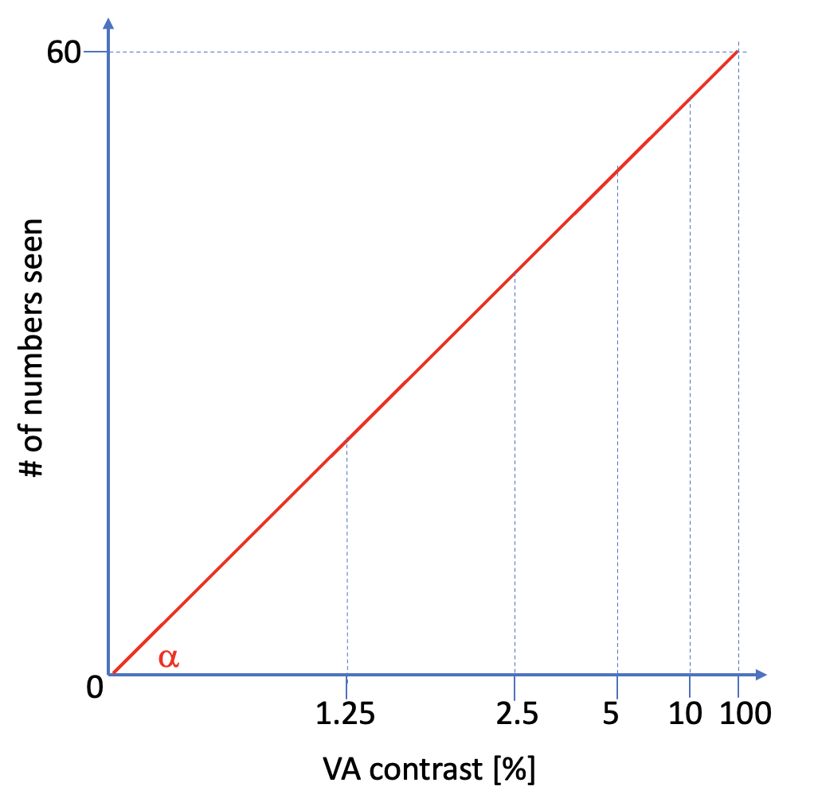
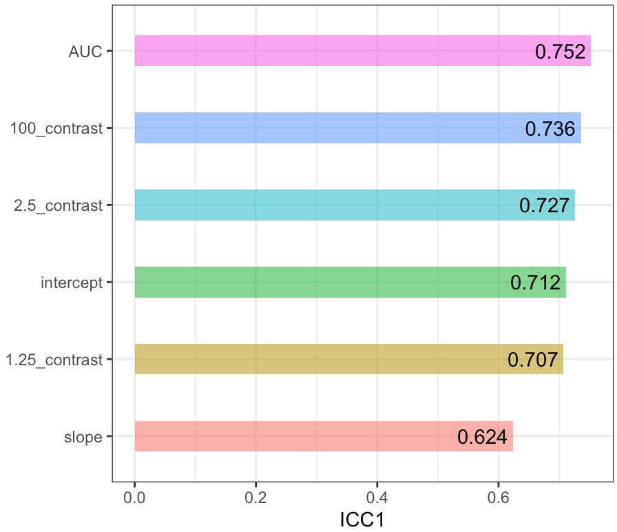
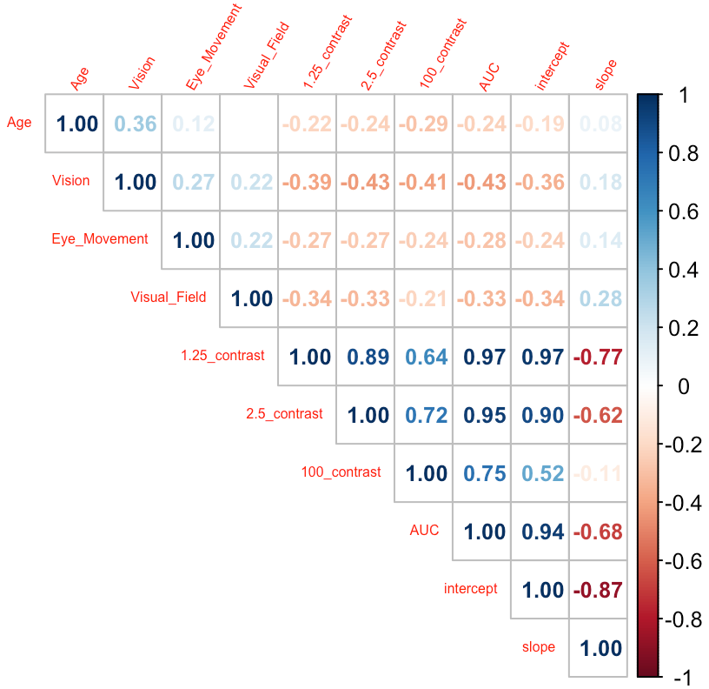
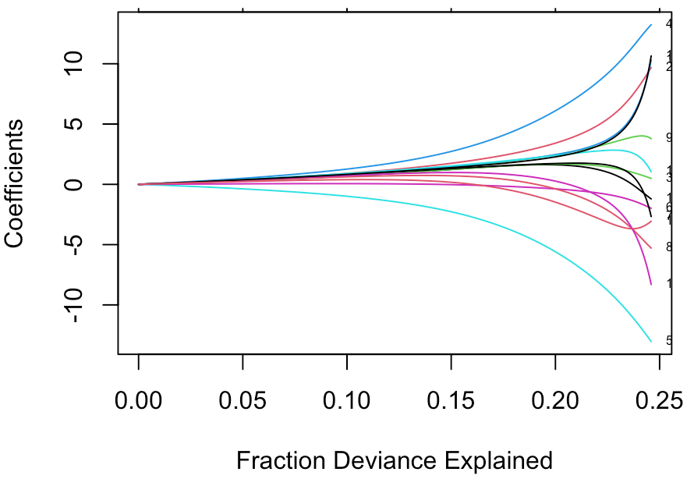
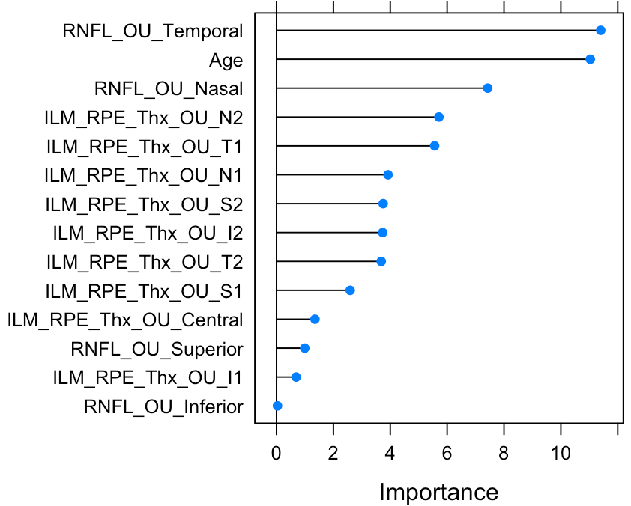
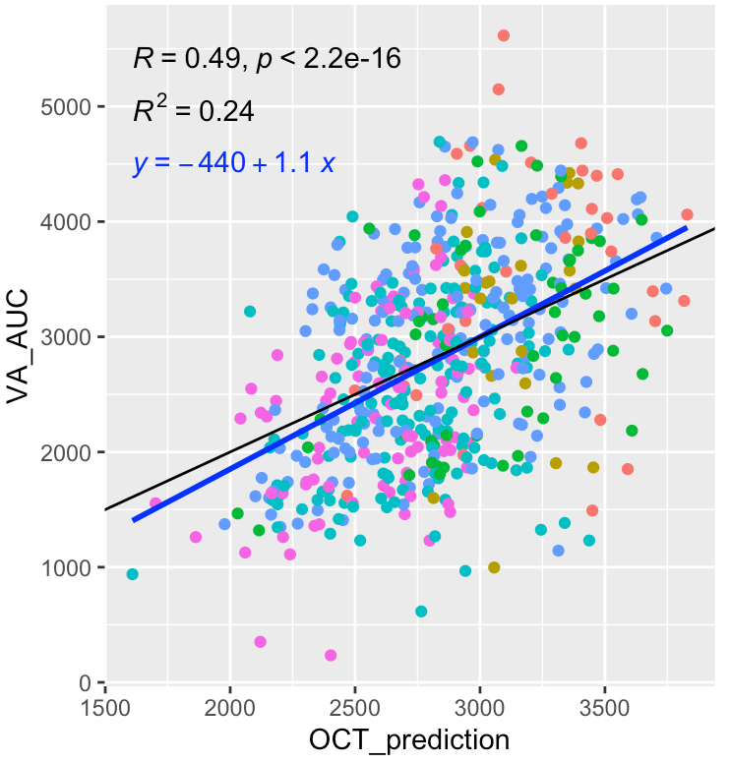
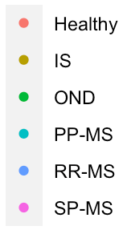
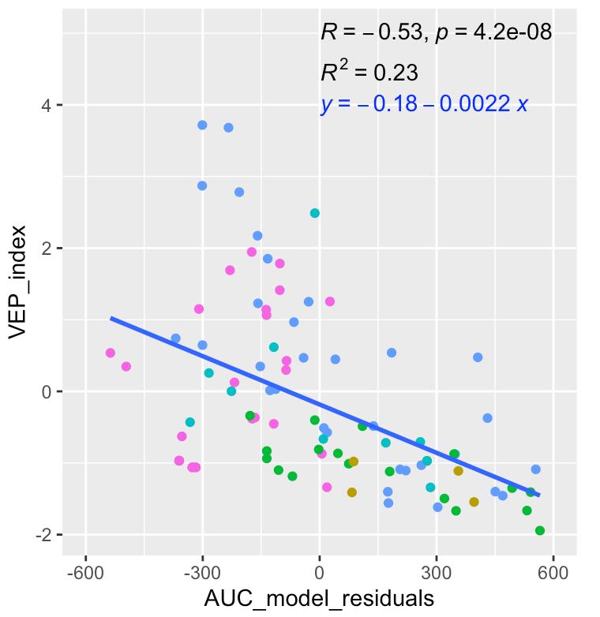
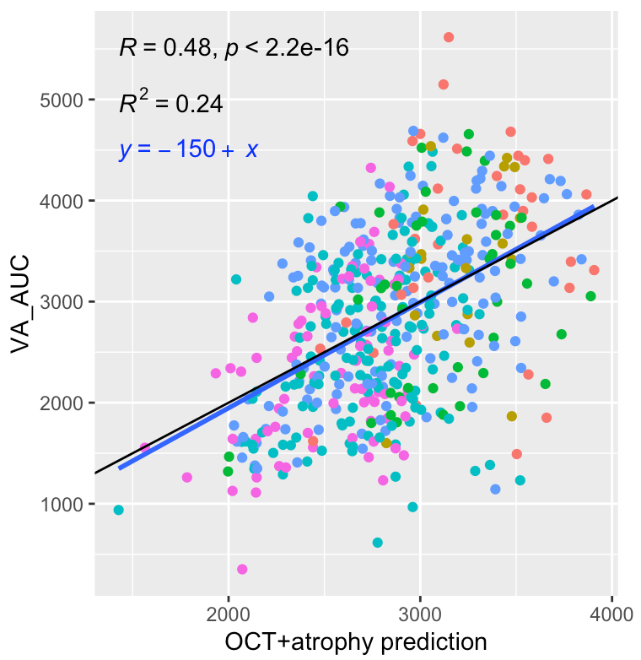
Investigating Structure-Function Relationship in Visual Pathway to Develop Optimized Measure for Visual Impairment in MS
Adam Shah; Peter Kosa, PhD; Bibiana Bielekova, MD
Neuroimmunological Diseases Section, NIH/NIAID
Objective
Methods
Conclusions
The shortage of neurologists worldwide evokes a need for more efficient diagnostic & patient monitoring measures for neurological diseases
Goal is to apply machine learning to understand relationships between different structural and functional visual outcomes
Derive single, optimized measurement of vision that can eventually be used in self-administered smartphone test
Develop linear model of VA at different contrasts in healthy donors
Calculate VA AUC from regression of all VA contrasts
Validate AUC measure through ICC analysis and correlations with existing clinical outcomes
Use elastic net regression to generate a model for VA AUC using OCT, VEP, and atrophy data
VA AUC has higher ICC, greater dynamic range and stronger correlations with clinician-derived outcomes of visual disability than currently used 1.25% contrast
OCT and VEP measurements have mostly non-overlapping effect on explanation of variance in the model
Brain atrophy measures and OCT outcomes explain overlapping portion of variance
There is additional variance in VA AUC not explained by the model, likely due to diseases anterior to retina or posterior visual pathway not reflected by brain atrophy
Introduction
Optical coherence tomography (OCT): structural integrity of the retina focusing on layer of axons and ganglion cells
Visual evoked potentials (VEP): speed of electrical conduction from retina to visual cortex – prolonged with demyelination
Brain parenchymal fraction (BPFr) and ventricular CSF volume: measures of global brain atrophy
Vision is measured by visual acuity (VA) collected under different contrasts. Visual disability based on VA at 1.25% contrast used in multiple sclerosis (MS) clinical trials
We hypothesize that fitting a linear model to these measurements will decrease measurement error; the area under the curve (AUC) will capture all contrasts, have greater dynamic range & less ceiling effect
Figure 1: Theoretical linear regression
model of VA contrasts to obtain AUC
Figure 2: VA AUC outperforms other VA measures in intraclass correlation coefficient (ICC) analysis
Figure 3: VA AUC shows strong correlations with existing clinical outcome measures
Results
Future Directions
Diffusion tensor imaging data focusing on visual pathway might explain more variance than BPFr
Assess use of VA AUC in clinical practice for tracking disease progression
Compare VA AUC from clinic and NDS developed smartphone app for patient monitoring
n=554
Training R²=0.24
Validation R² =0.24
Figure 4: Model of VA AUC based on OCT parameters and age
Figure 5: VEP explains portion of the residuals in OCT model
Acknowledgements
I would like to thank Dr. Bielekova, Dr. Kosa, and all the NDS staff for this opportunity and for their support throughout this project.
Figure 6: Adding atrophy parameters to the OCT model does not significantly increase variance explained
n=92
Training R²=0.22
Validation R²=0.24
n=481
Training R²=0.24
Validation R²=0.25

